Slide 2
Learning Objectives
At the end of this module, you will be able to:
Describe and explain the most important artifacts.
Describe the deliverables and their contents.

Slide 3

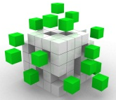

Core Concepts: Deliverables, Artifacts, and Building Blocks
Deliverables:
Specified by contracts.
Artifacts:
Building Blocks:
Are the most elementary components.
Reviewed, agreed, and signed-off by stakeholders.
Are parts of an architecture deliverable.
Are matrices, catalogs, or diagrams.
Describe aspects of architecture.
Are parts of an architecture artifact.
Have two interpretations – as IT component and as the instantiation of a building block type in the content metamodel.
Have two types – architecture building blocks and solution building blocks.
Specified by contracts.
Reviewed, Agreed, and Signed-off by stakeholders.

Slide 4
Artifacts
Architecture Principles, Vision, and Requirements
Preliminary
Architecture Vision
Architecture Requirements
Business Architecture
Information Systems Architecture
Technology Architecture
Motivation
Data
Application
Organization
Function
Architecture Realization
Opportunities, Solutions, and Migration Planning
Implementation Governance
Source: TOGAF® Version 9.1, The Open Group, 2011

Slide 5
Business Architecture Artifacts
Business Architecture
Catalogs
Organization/Actor Catalog
Driver/Goal/Objective Catalog
Role Catalog
Business Service/Function Catalog
Location Catalog
Process/Event/Control/Product Catalog
Contract/Measure Catalog
Matrices
Business Interaction Matrix
Actor/Role Matrix
Core Diagrams
Business Footprint Diagram
Business Service/Information Diagram
Functional Decomposition Diagram
Functional Decomposition Diagram
Product Lifecycle Diagram
Extension Diagrams
Goal/Objective/Service Diagram
Business Use-Case Diagram
Organization Decomposition Diagram
Process Flow Diagram
Event Diagram
Source: TOGAF® Version 9.1, The Open Group, 2011

Slide 6
Driver/Goal/Objective Catalog
Business Architecture
Driver/Goal/Objective Catalog
The purpose of the Driver/Goal/Objective catalog is to provide a cross-organizational reference of how an organization meets its drivers in practical terms through goals, objectives, and (optionally) measures.
Publishing a definitive breakdown of drivers, goals, and objectives allows change initiatives within the enterprise to identify synergies across the organization, which in turn allow stakeholders to be identified and related change initiatives to be aligned or consolidated.
Catalogs
Organization/Actor Catalog
Driver/Goal/Objective Catalog
Role Catalog
Business Service/Function Catalog
Location Catalog
Process/Event/Control/Product Catalog
Contract/Measure Catalog
Matrices
Business Interaction Matrix
Actor/Role Matrix
Core Diagrams
Business Footprint Diagram
Business Service/Information Diagram
Functional Decomposition Diagram
Functional Decomposition Diagram
Product Lifecycle Diagram
Extension Diagrams
Goal/Objective/Service Diagram
Business Use-Case Diagram
Organization Decomposition Diagram
Process Flow Diagram
Event Diagram

Slide 7
Driver/Goal/Objective Catalog
Goals
Increase the quality of our education and the success of our students.
Strengthen our cooperation with other higher education institutions develop joint education programs.
Strengthen our cooperation with businesses in the region to transfer knowledge.
Increase the reuse of research results and research data within education and research.
Keep focus on limiting overhead costs and maintain current educational staff levels.
Objectives
Increase the number of students in honors programs from 9% to 12%.
Decrease the dropout rate of students after one year from 18% to 15%.
Decrease the switch rate of students to another program from 7% to 6%.
Increase the number students that obtain a degree certificate from 74% to 77%.
Increase the percentage of lecturers with a basic teaching qualification from 20% to 60%.
Increase the spend of all public government research grants on valorization to 2.5%.
Maintain a maximum of 20% for the ration between overhead and turnover.

Slide 8
Functional Decomposition Diagram
Business Architecture
Functional Decomposition Diagram
The purpose of the Functional Decomposition diagram is to show on a single page the capabilities of an organization that are relevant to the consideration of an architecture.
By examining the capabilities of an organization from a functional perspective, it is possible to quickly develop models of what the organization does without being dragged into extended debate on how the organization does it.
Once a basic Functional Decomposition diagram has been developed, it becomes possible to layer heat-maps on top of this diagram to show scope and decisions. For example, the capabilities to be implemented in different phases of a change program.
Catalogs
Organization/Actor Catalog
Driver/Goal/Objective Catalog
Role Catalog
Business Service/Function Catalog
Location Catalog
Process/Event/Control/Product Catalog
Contract/Measure Catalog
Matrices
Business Interaction Matrix
Actor/Role Matrix
Core Diagrams
Business Footprint Diagram
Business Service/Information Diagram
Functional Decomposition Diagram
Functional Decomposition Diagram
Product Lifecycle Diagram
Extension Diagrams
Goal/Objective/Service Diagram
Business Use-Case Diagram
Organization Decomposition Diagram
Process Flow Diagram
Event Diagram

Slide 9
Functional Decomposition Diagram
Control
Strategy and Policy
Improvement
Reporting
Portfolio Management
Education
Research
Education Development
Registration
Request
Finalization
Marketing and Sales
Provide Education
Preparation
Knowledge Exposure
Planning and Scheduling
Test and Certify
Execution
Exploitation
Support
Human Resource Management
Finance
Facility Management
Document Management
Information Technology
Relationship Management
Procurement
Communication
Legal

Slide 10
Process Flow Diagram
Business Architecture
Process Flow Diagram
The purpose of the Process Flow diagram is to depict all models and mappings related to the process metamodel entity.
Process Flow diagrams show sequential flow of control between activities and may utilize swim-lane techniques to represent ownership and realization of process steps. For example, the appli-cation that supports a process step may be shown as a swim-lane.
In addition to showing a sequence of activity, process flows can also be used to detail the controls that apply to a process, the events that trigger or result from completion of a process, and also the products that are generated from process execution.
Process Flow diagrams are useful in elaborating the architecture with subject specialists, as they allow the specialist to describe "how the job is done" for a particular function. Through this process, each process step can become a more fine-grained function and can then in turn be elaborated as a process.
Catalogs
Organization/Actor Catalog
Driver/Goal/Objective Catalog
Role Catalog
Business Service/Function Catalog
Location Catalog
Process/Event/Control/Product Catalog
Contract/Measure Catalog
Matrices
Business Interaction Matrix
Actor/Role Matrix
Core Diagrams
Business Footprint Diagram
Business Service/Information Diagram
Functional Decomposition Diagram
Functional Decomposition Diagram
Product Lifecycle Diagram
Extension Diagrams
Goal/Objective/Service Diagram
Business Use-Case Diagram
Organization Decomposition Diagram
Process Flow Diagram
Event Diagram

Slide 11
Process Flow Diagram
Applicant
Apply for Education
Pay Tuition Fees
Administration Department
Register Application
Review Application
Construct Agreement
Financial Department
Send Invoice
Receive Payment

Slide 12
Information Systems Architectures Artifacts
Data Architecture
Catalogs
Data Entity/Data Component Catalog
Matrices
Data Entity/Business Function Matrix
Application/Data Matrix
Core Diagrams
Conceptual Data Diagram
Logical Data Diagram
Data Dissemination Diagram
Extension Diagrams
Data Security Diagram
Data Migration Diagram
Data Lifecycle Diagram
Source: TOGAF® Version 9.1, The Open Group, 2011

Slide 13
Conceptual Data Diagram
Data Architecture
Conceptual Data Diagram
The key purpose of the Conceptual Data diagram is to depict the relationships between critical data entities within the enterprise.
This diagram is developed to clearly present the relationships and to help understand the lower-level data models for the enterprise.
Catalogs
Data Entity/Data Component Catalog
Matrices
Data Entity/Business Function Matrix
Application/Data Matrix
Core Diagrams
Conceptual Data Diagram
Logical Data Diagram
Data Dissemination Diagram
Extension Diagrams
Data Security Diagram
Data Migration Diagram
Data Lifecycle Diagram

Slide 14
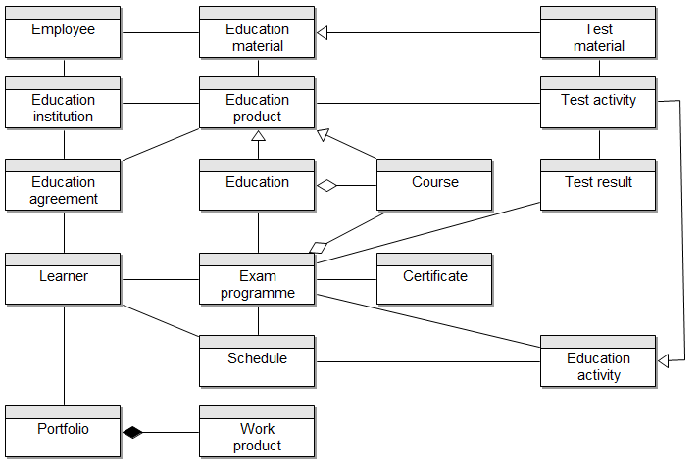
Conceptual Data Diagram

Slide 15
Application/Data Matrix
Data Architecture
Application/Data Matrix
The purpose of the Application/Data matrix is to depict the relationship between applications (i.e., application components) and the data entities that are accessed and updated by them.
The mapping of the Application Component-Data Entity relationship is an important step as it enables the following to take place:
Assign access of data to specific applications in the organization
Understand the degree of data duplication within different applications, and the scale of the data lifecycle
Understand where the same data is updated by different applications
Support the gap analysis and determine whether any of the applications are missing and as a result need to be created
The Application/Data matrix is a two-dimensional table with Logical Application Component on one axis and Data Entity on the other axis.
Catalogs
Data Entity/Data Component Catalog
Matrices
Data Entity/Business Function Matrix
Application/Data Matrix
Core Diagrams
Conceptual Data Diagram
Logical Data Diagram
Data Dissemination Diagram
Extension Diagrams
Data Security Diagram
Data Migration Diagram
Data Lifecycle Diagram

Slide 16
Application/Data Matrix
 | Employee | Education material | Test material | Education institution | Education product | Education | Course | Test result | Learner | Exam program | Certificate | Schedule | Education activity | Portfolio | Work product
Learning Management System |  | X |  |  |  |  |  |  |  |  |  |  |  | X | X
Student Information System |  |  |  |  | X | X | X | X | X | X | X |  | X
Digital Test System |  |  | X
Scheduling System |  |  |  |  |  |  |  |  |  |  |  | X
HR System | X |  |  | X

Slide 17
Data Entity/Business Function Matrix
Data Architecture
Data Entity/Business Function Matrix
The purpose of the Data Entity/Business Function matrix is to depict the relationship between data entities and business functions within the enterprise.
The mapping of the Data Entity-Business Function relationship enables the following to take place:
Assign ownership of data entities to organizations
Understand the information exchange requirements business services
Support the gap analysis and determine whether any data entities are missing and need to be created
Define system of origin, system of record, and system of reference for data entities
Enable development of data governance programs across the enterprise
Catalogs
Data Entity/Data Component Catalog
Matrices
Data Entity/Business Function Matrix
Application/Data Matrix
Core Diagrams
Conceptual Data Diagram
Logical Data Diagram
Data Dissemination Diagram
Extension Diagrams
Data Security Diagram
Data Migration Diagram
Data Lifecycle Diagram

Slide 18
Data Entity/Business Function Matrix
 | Employee | Education material | Test material | Education institution | Education product | Test activity | Education | Course | Test result | Learner | Exam program | Certificate | Schedule | Education activity | Portfolio | Work product
Education Development | R | C | C | R | C |  | C | C
Marketing and Sales | R |  |  | R | R |  | R | R
Planning and Scheduling | R |  |  | R | R |  | R | R |  |  |  |  | C
Registration | R |  |  | R | R |  | R | R |  | C | C | R |  |  | R
Provide Education | R | R | R | R | R |  | R | R |  | R | R |  | R | C | C | C
Test and Certify | R | R |  | R | R | C | R | R | C | R | R | C | R | C

Slide 19
Information Systems Architectures Artifacts
Application Architecture
Catalogs
Application Portfolio Catalog
Interface Catalog
Matrices
Application/Organization Matrix
Role/Application Matrix
Application/Function Matrix
Application Interaction Matrix
Core Diagrams
Application Communication Diagram
Application and User Location Diagram
Application Use-Case Diagram
Extension Diagrams
Enterprise Manageability Diagram
Process/Application Realization Diagram
Software Engineering Diagram
Application Migration Diagram
Software Distribution Diagram
Source: TOGAF® Version 9.1, The Open Group, 2011

Slide 20
Data Entity/Business Function Matrix
Application Architecture
Application Portfolio Catalog
The purpose of this catalog is to identify and maintain a list of all the applications in the enterprise.
This list helps to define the horizontal scope of change initiatives that may impact particular kinds of applications.
An agreed Application Portfolio allows a standard set of applications to be defined and governed.
The Application Portfolio catalog provides a foundation on which to base the remaining matrices and diagrams. It is typically the start point of the Application Architecture phase.
Catalogs
Application Portfolio Catalog
Interface Catalog
Matrices
Application/Organization Matrix
Role/Application Matrix
Application/Function Matrix
Application Interaction Matrix
Core Diagrams
Application Communication Diagram
Application and User Location Diagram
Application Use-Case Diagram
Extension Diagrams
Enterprise Manageability Diagram
Process/Application Realization Diagram
Software Engineering Diagram
Application Migration Diagram
Software Distribution Diagram

Slide 21
Application Portfolio Catalog
Application | Description
Learning Management System | This is the core education system, providing students and lecturers with a place to exchange education materials, exercises and exercise results. It also provides collaboration mechanisms to facilitate discussions and teleconferences.
Student information system | This is the core administration system that administers information about students, teaching programmes, courses and grades.
Digital test system | This system supports conducting tests to determine whether learners have acquired the right knowledge and skills.
Scheduling system | This system schedules the various courses in time, and ensures that the necessary resources such as lecturers and rooms are available.
Research administration system | This system supports the administration of research results, and is available to researches as well as instructors and students
Financial system | This is where the general ledger is maintained, and also supports collections and disbursement processes
HR system | This system administers employees, their competencies and their salaries. It also provides self-service functionality for employees where they can see and change their own personal information.
Procurement system | This system supports the procurement process, as well as the administration of suppliers and contracts.
Portal | This system provides personalized access to the most important information for students, lecturers and employees. It also hosts the general web-site of the university.

Slide 22
Application Communication Diagram
Application Architecture
Application Communication Diagram
The purpose of the Application Communication diagram is to depict all models and mappings related to communication between applications in the metamodel entity.
It shows application components and interfaces between components.
Interfaces may be associated with data entities where appropriate.
Applications may be associated with business services where appropriate.
Communication should be logical and should only show intermediary technology where it is architecturally relevant.
Catalogs
Application Portfolio Catalog
Interface Catalog
Matrices
Application/Organization Matrix
Role/Application Matrix
Application/Function Matrix
Application Interaction Matrix
Core Diagrams
Application Communication Diagram
Application and User Location Diagram
Application Use-Case Diagram
Extension Diagrams
Enterprise Manageability Diagram
Process/Application Realization Diagram
Software Engineering Diagram
Application Migration Diagram
Software Distribution Diagram

Slide 23
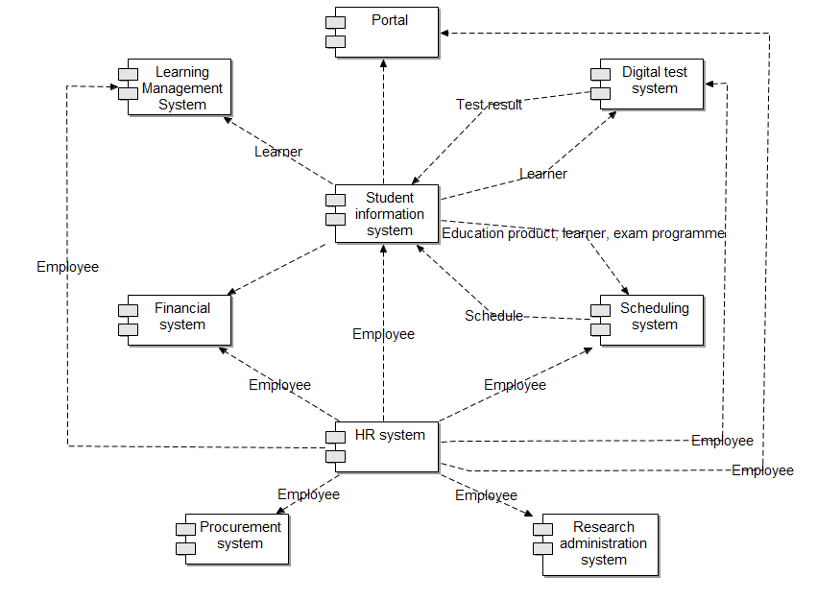
Application Communication Diagram

Slide 24
Application/Function Matrix
Application Architecture
Application/Function Matrix
The purpose of the Application/Function matrix is to depict the relationship between applications and business functions within the enterprise.
The mapping of the Application Component-Function relationship is an important step as it enables the following to take place:
Assign usage of applications to the business functions that are supported by them
Understand the application support requirements of the business services and processes carried out
Support the gap analysis and determine whether any of the applications are missing and as a result need to be created
Define the application set used by a particular business function
Catalogs
Application Portfolio Catalog
Interface Catalog
Matrices
Application/Organization Matrix
Role/Application Matrix
Application/Function Matrix
Application Interaction Matrix
Core Diagrams
Application Communication Diagram
Application and User Location Diagram
Application Use-Case Diagram
Extension Diagrams
Enterprise Manageability Diagram
Process/Application Realization Diagram
Software Engineering Diagram
Application Migration Diagram
Software Distribution Diagram

Slide 25
Application/Function Matrix
 | Education development | Marketing and sales | Planning and scheduling | Registration | Provide education | Test and certify
Learning Management System | X |  |  |  | X
Student Information System | X | X | X | X | X | X
Digital Test System |  |  |  |  |  | X
Scheduling System |  |  | X
HR System | X | X | X | X | X | X

Slide 26
Application Use-Case Diagram
Application Architecture
Application Use-Case Diagram
An Application Use-Case diagram displays the relationships between consumers and providers of application services. Application services are consumed by actors or other application services and the Application Use-Case diagram provides added richness in describing application functionality by illustrating how and when that functionality is used.
The purpose of the System Use-Case diagram is to help to describe and validate the interaction between actors and their roles with applications. As the architecture progresses, the use-case can evolve from functional information to include technical realization detail.
Application use-cases can also be re-used in more detailed systems design work.
Catalogs
Application Portfolio Catalog
Interface Catalog
Matrices
Application/Organization Matrix
Role/Application Matrix
Application/Function Matrix
Application Interaction Matrix
Core Diagrams
Application Communication Diagram
Application and User Location Diagram
Application Use-Case Diagram
Extension Diagrams
Enterprise Manageability Diagram
Process/Application Realization Diagram
Software Engineering Diagram
Application Migration Diagram
Software Distribution Diagram

Slide 27
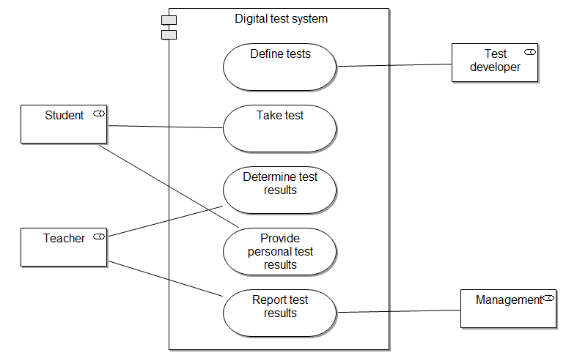
Application Use-Case Diagram

Slide 28
Technology Architecture Artifacts
Technology Architecture
Catalogs
Technology Standards Catalog
Technology Portfolio Catalog
Matrices
Application/Technology Matrix
Core Diagrams
Environments and Locations Diagram
Platform Decomposition Diagram
Extension Diagrams
Processing Diagram
Networked Computing/ Hardware Diagram
Communications Engineering Diagram
Benefits Diagram
Source: TOGAF® Version 9.1, The Open Group, 2011

Slide 29
Environments and Locations Diagram
Technology Architecture
Technology Standards Catalog
The Technology Standards catalog documents the agreed standards for technology across the enterprise covering technologies, and versions, the technology lifecycles, and the refresh cycles for the technology.
Depending upon the organization, this may also include location or business domain-specific standards information.
This catalog provides a snapshot of the enterprise standard technologies that are or can be deployed, and also helps identify the discrepancies across the enterprise.
If technology standards are currently in place, apply these to the Technology Portfolio catalog to gain a baseline view of compliance with technology standards.
Catalogs
Technology Standards Catalog
Technology Portfolio Catalog
Matrices
Application/Technology Matrix
Core Diagrams
Environments and Locations Diagram
Platform Decomposition Diagram
Extension Diagrams
Processing Diagram
Networked Computing/ Hardware Diagram
Communications Engineering Diagram
Benefits Diagram

Slide 30
Technology Standards Catalog
Technology | Area of application
Java | Programming language for custom-built back-office applications.
IBM WebSphere Application Server | Application server for all custom-built back-office applications.
IBM DB2 | Database server for all back-office applications.
Microsoft .NET | Application server for all custom-built front-office applications.
Microsoft SQL Server | Database server for all front-office applications.
IBM Tivoli | Identity and Access management.
Microsoft Active Directory | Directory server for all Microsoft applications.

Slide 31
Environments and Locations Diagram
Technology Architecture
Environments and Locations Diagram
The Environments and Locations diagram depicts which locations host which applications, identifies what technologies and/or applications are used at which locations, and finally identifies the locations from which business users typically interact with the applications.
This diagram should also show the existence and location of different deployment environments, including non-production environments, such as development and pre production.
Catalogs
Technology Standards Catalog
Technology Portfolio Catalog
Matrices
Application/Technology Matrix
Core Diagrams
Environments and Locations Diagram
Platform Decomposition Diagram
Extension Diagrams
Processing Diagram
Networked Computing/ Hardware Diagram
Communications Engineering Diagram
Benefits Diagram

Slide 32
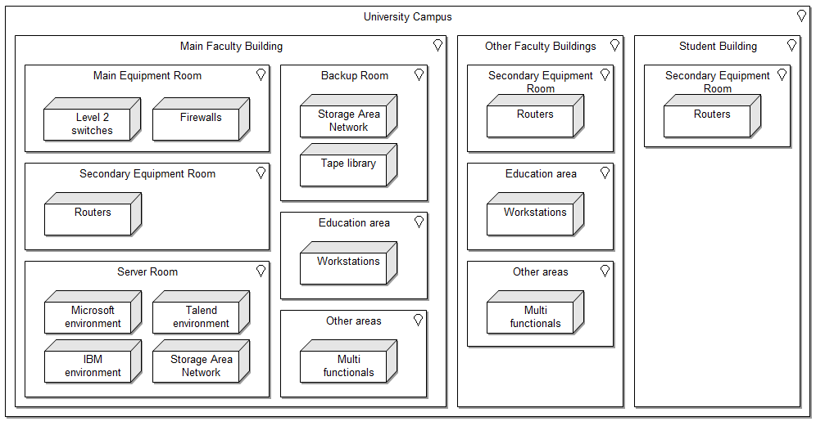
Environments and Locations Diagram

Slide 33
Platform Decomposition Diagram
Technology Architecture
Platform Decomposition Diagram
The Platform Decomposition diagram depicts the technology platform that supports the operations of the Information Systems Architecture.
The diagram covers all aspects of the infrastructure platform and provides an overview of the enterprise's technology platform.
The diagram can be expanded to map the technology platform to appropriate application components within a specific functional or process area.
This diagram may show details of specification, such as product versions, number of CPUs, etc. or simply could be an informal "eye-chart" providing an overview of the technical environment.
Catalogs
Technology Standards Catalog
Technology Portfolio Catalog
Matrices
Application/Technology Matrix
Core Diagrams
Environments and Locations Diagram
Platform Decomposition Diagram
Extension Diagrams
Processing Diagram
Networked Computing/ Hardware Diagram
Communications Engineering Diagram
Benefits Diagram

Slide 34
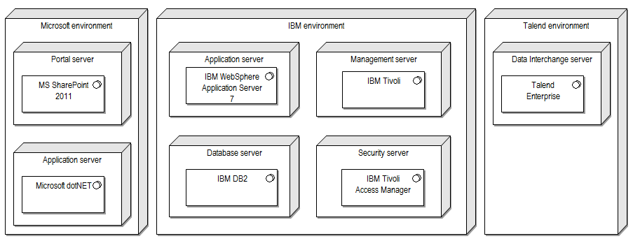
Platform Decomposition Diagram

Slide 35
Networked Computing/Hardware Diagram
Technology Architecture
Networked Computing/Hardware Diagram
It is a common practice for applications to be deployed and hosted in a shared and common infrastructure environment.
So it becomes highly critical to document the mapping between logical applications and the technology components (e.g., server) that supports the application both in the development and production environments.
The purpose of this diagram is to show the "as deployed" logical view of logical application components in a distributed network computing environment.
Catalogs
Technology Standards Catalog
Technology Portfolio Catalog
Matrices
Application/Technology Matrix
Core Diagrams
Environments and Locations Diagram
Platform Decomposition Diagram
Extension Diagrams
Processing Diagram
Networked Computing/ Hardware Diagram
Communications Engineering Diagram
Benefits Diagram

Slide 36
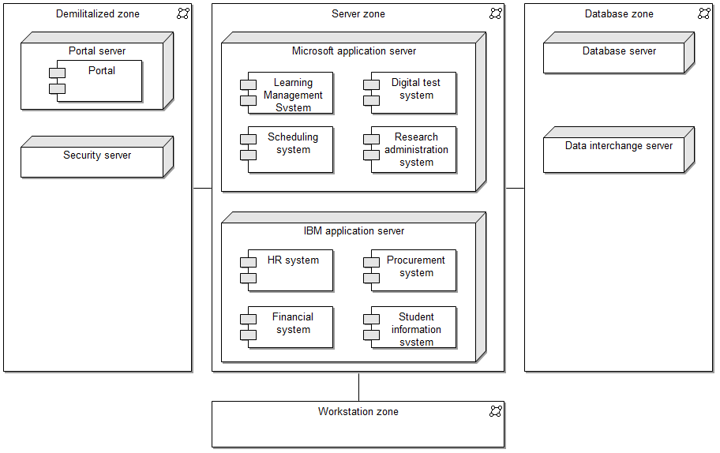
Networked Computing/Hardware Diagram

Slide 37
Communications Engineering Diagram
Technology Architecture
Communications Engineering Diagram
The Communications Engineering diagram describes the means of communication - the method of sending and receiving information - between these assets in the Technology Architecture; insofar as the selection of package solutions in the preceding architectures put specific requirements on the communications between the applications.
The Communications Engineering diagram will take logical connections between client and server components and identify network boundaries and network infrastructure required to physically implement those connections.
It does not describe the information format or content, but will address protocol and capacity issues.
Catalogs
Technology Standards Catalog
Technology Portfolio Catalog
Matrices
Application/Technology Matrix
Core Diagrams
Environments and Locations Diagram
Platform Decomposition Diagram
Extension Diagrams
Processing Diagram
Networked Computing/ Hardware Diagram
Communications Engineering Diagram
Benefits Diagram

Slide 38
Communications Engineering Diagram
Location 1
Server room
Main equipment room
Secondary equipment room (17)
Other rooms
Server
Layer 3 Switch
4 x 1Gb FO etherchannel
Layer 3
Switch
Firewall
Switch
Switches
Work station
CAT5 (e) – 100 Mb
Server
Layer 3 Switch
4 x 1Gb FO etherchannel
Layer 3
Switch
Router
Firewall
Firewall
glassfibre– 100 Mb
Location 2
Combined equipment room
Secondary equipment room
Other rooms
Student dormitory 1
glassfibre
CAT6 – 10 Gb
glassfibre– 1Gb
optical laser connection– 100 Mb
Switches
Switches
Work station
Internet
Student dormitory 2

Slide 39
Relationship of Artifacts with Content Metamodel
 | Driver/Goal/Objective Catalog | Functional Decomposition Diagram | Process Flow Diagram | Conceptual Data Diagram | Application/Data Matrix | Data Entity/Business Function Matrix | Application Portfolio Catalog | Application Communication Diagram | Application/Function Matrix | Application Use-Case Diagram | Technology Standards Catalog | Environments and Locations Diagram | Platform Decomposition Diagram | Networked Computing/Hardware Diagram | Communications Engineering Diagram
Driver/goal/objective | X
Function |  | X |  |  |  | X |  |  | X
Process |  |  | X
Data Entity |  |  |  | X | X | X |  | X
Application component |  |  |  |  | X |  | X | X | X | X |  |  |  | X
Technology component |  |  |  |  |  |  |  |  |  |  | X | X | X | X | X
Location |  |  |  |  |  |  |  |  |  |  |  | X |  |  | X

Slide 40
Deliverables
Process and governance
Organizational Model for Enterprise Architecture
Tailored Architecture Framework
Business Principles, Business Preliminary Goals, and Business Drivers
Capability Assessment
Request for Architecture Work
Statement of Architecture Work
Communications Plan
Implementation Governance Model
Architecture Contract
Compliance Assessment
Change Request
Requirements Impact Assessment
Architecture content
Architecture Requirements
Architecture Principles
Architecture Vision
Architecture Definition Document
Architecture Roadmap
Implementation and Migration Plan
Architecture Repository
Architecture Building Blocks
Solution Building Blocks

Slide 41
Deliverables
Organizational Model for Enterprise Architecture
In order for an architecture framework to be used successfully, it must be supported by the correct organization, roles, and responsibilities within the enterprise. Of particular importance is the definition of boundaries between different enterprise architecture practitioners and the governance relationships that span across these boundaries.
Typical contents of an Organizational Model for enterprise architecture are:
Scope of organizations impacted
Maturity assessment, gaps, and resolution approach
Roles and responsibilities for architecture team(s)
Constraints on architecture work
Budget requirements
Governance and support strategy

Slide 42
Deliverables
Tailored Architecture Framework
Tailoring of TOGAF may be necessary to fit it to the specific context.
Tailoring to the organizational context
Tailoring to the architecture project
Typical contents of a Tailored Architecture Framework are:
Tailored architecture method
Tailored architecture content (deliverables and artifacts)
Configured and deployed tools
Interfaces with governance models and other frameworks:
Corporate Business Planning
Enterprise Architecture
Portfolio, Program, Project Management
System Development/Engineering
Operations (Services)

Slide 43
Deliverables
Capability Assessment
Before embarking upon a detailed Architecture Definition, it is valuable to understand the baseline and target capability level of the enterprise.
What is the capability level of the enterprise as a whole?
What is the capability or maturity level of the IT function within the enterprise?
What is the capability and maturity of the architecture function within the enterprise?
Typical contents of a Capability Assessment are:
Business Capability Assessment
IT Capability Assessment
Architecture maturity assessment
Business Transformation Readiness Assessment

Slide 44
Deliverables
Request for Architecture Work
This is a document that is sent from the sponsoring organization to the architecture organization to trigger the start of an architecture development cycle.
Requests for Architecture Work typically include:
Organization sponsors
Organization's mission statement
Business goals (and changes)
Strategic plans of the business
Time limits
Changes in the business environment
Organizational constraints
Budget information, financial constraints
External constraints, business constraints
Current business system description
Current architecture/IT system description
Description of developing organization
Description of resources available to developing organization

Slide 45
Deliverables
Statement of Architecture Work
The Statement of Architecture Work defines the scope and approach that will be used to complete an architecture project. The Statement of Architecture Work is typically the document against which successful execution of the architecture project will be measured and may form the basis for a contractual agreement between the supplier and consumer of architecture services.
Typical contents of a Statement of Architecture Work are:
Title
Architecture project request and background
Architecture project description and scope
Overview of Architecture Vision
Specific change of scope procedures
Roles, responsibilities, and deliverables
Acceptance criteria and procedures
Architecture project plan and schedule
Approvals

Slide 46
Deliverables
Implementation Governance Model
Once an architecture has been defined, it is necessary to plan how the architecture will be governed through implementation.
The Implementation Governance Model ensures that a project transitioning into implementation also smoothly transitions into appropriate architecture governance.
Typical contents of an Implementation Governance Model are:
Governance processes
Governance organization structure
Governance roles and responsibilities
Governance checkpoints and success/failure criteria

Slide 47
Deliverables
Compliance Assessment
Once an architecture has been defined, it is necessary to govern that architecture through implementation to ensure that the original Architecture Vision is appropriately realized and that any implementation learnings are fed back into the architecture process.
Typical contents of a Compliance Assessment are:
Overview of project progress and status
Overview of project architecture/design
Completed architecture checklists:
Hardware and operating system checklist
Software services and middleware checklist
Applications checklists
Information management checklists
Security checklists
System management checklists
System engineering checklists
Methods and tools checklists

Slide 48
Deliverables
Change Request
During implementation of an architecture it is possible that the architecture and requirements are not suitable or are not sufficient.
Additionally, external factors may open up opportunities to extend and refine the architecture.
In these circumstances, a Change Request may be submitted in order to kick-start a further cycle of architecture work.
Typical contents of a Change Request are:
Description of the proposed change
Rationale for the proposed change
Impact assessment of the proposed change
Repository reference number

Slide 49
Deliverables
Architecture Requirements Specification
The Architecture Requirements Specification provides a set of quantitative statements that outline what an implementation project must do in order to comply with the architecture.
Typical contents of an Architecture Requirements Specification are:
Success measures
Architecture requirements
Business service contracts
Application service contracts
Implementation guidelines
Implementation specifications
Implementation standards
Interoperability requirements
Constraints
Assumptions

Slide 50
Deliverables
Architecture Vision
The Architecture Vision is created early on in the ADM cycle. It provides a summary of the changes to the enterprise that will accrue from successful deployment of the Target Architecture. The purpose of the Architecture Vision is to provide key stakeholders with a formally agreed outcome.
Typical contents of an Architecture Vision are:
Problem description
Stakeholders, concerns, issues/scenarios
Objective of the Statement of Architecture Work
Summary views necessary for the Request for Architecture Work
Mapped requirements
Reference to Draft Architecture Definition Document

Slide 51
Deliverables
Architecture Definition Document
The Architecture Definition Document is the deliverable container for the core architectural artifacts created during a project.
Typical contents of an Architecture Definition Document are:
Scope
Goals, objectives, and constraints
Architecture principles
Baseline Architecture
Architecture models (for each state to be modeled):
Rationale and justification for architectural approach
Mapping to Architecture Repository:
Gap analysis
Impact assessment

Slide 52
Deliverables
Architecture Roadmap
The Architecture Roadmap lists individual work packages that will realize the Target Architecture and lays them out on a timeline to show progression from the Baseline Architecture to the Target Architecture.
Typical contents of an Architecture Roadmap are:
Work package portfolio:
Description, functional requirements, dependencies, business value
Implementation Factor Assessment and Deduction matrix, including:
Risks, issues, assumptions, dependencies, actions, inputs
Consolidated Gaps, Solutions, and Dependencies matrix, including:
Architecture domain, gap, potential solutions, dependencies
Any Transition Architectures
Implementation recommendations:
Criteria measures of effectiveness of projects, risks and issues, solution Building Blocks

Slide 53
Deliverables
Implementation and Migration Plan
The Implementation and Migration Plan provides a schedule for implementation of the solution described by a Transition Architecture.
Typical contents of an Implementation and Migration Plan are:
Implementation and Migration Strategy
Strategic implementation direction
Implementation sequencing approach
Project and portfolio breakdown of implementation:
Allocation of work packages to project and portfolio, capabilities delivered by projects, milestones and timing, work breakdown structure
It may contain:
Project charters
Capabilities, work packages, business value, risks, issues, assumptions, dependencies, resource requirements, costs

Slide 54
Deliverables
Requirements Impact Assessment
Throughout the ADM, new information is collected relating to an architecture. As this information is gathered, new facts may come to light that invalidate existing aspects of the architecture. A Requirements Impact Assessment assesses the current architecture requirements and specification to identify changes that should be made and the implications of those changes.
Typical contents of a Requirements Impact Assessment are:
Reference to specific requirements
Stakeholder priority of the requirements to date
Phases to be revisited
Phase to lead on requirements prioritization
Results of phase investigations and revised priorities
Recommendations on management of requirements
Repository reference number

Slide 55
Summary
In this module, you learned about:
The most important artifacts in the architecture content framework.
The deliverables.

